Slide 1


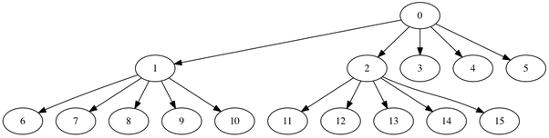
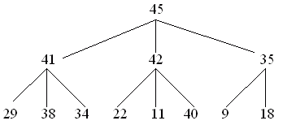
K-ARRAY HEAP
K-ary heap is a priority queue data structure, a generalization of the binary heap in which the nodes have d children instead of 2.
Nearly complete binary tree, with all levels having maximum number of nodes except the last, which is filled in left to right manner.
It can be divided into two categories:
(a) Max k-ary heap: Key at root is greater than all descendants and same is recursively true for all nodes
(b) Min k-ary heap: Key at root is lesser than all descendants and same is recursively true for all nodes
3-ary max heap
5-ary min heap

Slide 2

K-ARRAY HEAP
IMPLEMENTATION
Assuming 0 based indexing of array, an array represents a K-ary heap such that for any node we consider:
Parent of the node at index i (except root node) is located at index (i-1)/k
Children of the node at index i are at indices (k*i)+1 , (k*i)+2 …. (k*i)+k
The last non-leaf node of a heap of size n is located at index (n-2)/k

Slide 3
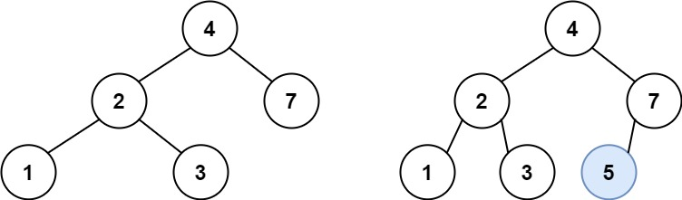
K-ARRAY HEAP
IMPLEMENTATION
insert() : Inserting a node into the heap
Notes:
Why do we start the loop from the last non-leaf node ?
Because all the nodes after that are leaf nodes which will trivially satisfy the heap property as they don’t have any children and hence, are already roots of a K-ary max heap.

Slide 4
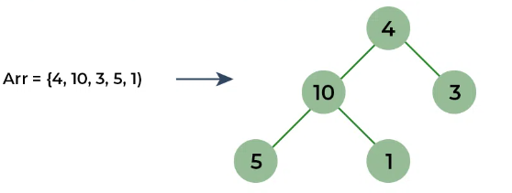
K-ARRAY HEAP
IMPLEMENTATION
buildHeap() : Builds a heap from an input array.
Notes:
Why do we start the loop from the last non-leaf node ?
Because all the nodes after that are leaf nodes which will trivially satisfy the heap property as they don’t have any children and hence, are already roots of a K-ary max heap.

Slide 5
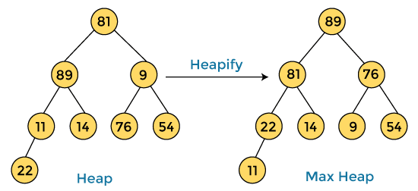
K-ARRAY HEAP
IMPLEMENTATION
restoreDown() /maxHeapify() : Used to maintain heap property
Notes:
Why do we start the loop from the last non-leaf node ?
Because all the nodes after that are leaf nodes which will trivially satisfy the heap property as they don’t have any children and hence, are already roots of a K-ary max heap.

Slide 6
K-ARRAY HEAP
IMPLEMENTATION
extractMax() : Extacting the root node.
Notes:
Why do we start the loop from the last non-leaf node ?
Because all the nodes after that are leaf nodes which will trivially satisfy the heap property as they don’t have any children and hence, are already roots of a K-ary max heap.

Slide 7
import java.util.*;
public class Main {
static void heapify(ArrayList<Integer> heap, int i, int k){
int smallest = i;
for (int j = 1; j <= k; j++) {
int child = k * i + j;
if (child < heap.size() && heap.get(child) < heap.get(smallest)) smallest = child;
}
if (smallest != i) {
Collections.swap(heap, i, smallest);
heapify(heap, smallest, k);
}
}
static void insert(ArrayList<Integer> heap, int key, int k) {
heap.add(key);
int i = heap.size() - 1;
while (i > 0 && heap.get((i - 1) / k) > heap.get(i)) {
Collections.swap(heap, (i - 1) / k, i);
i = (i - 1) / k;
}
}
public static void main(String[] args) {
ArrayList<Integer> heap = new ArrayList<>();
int k = 3;
insert(heap, 10, k);insert(heap, 5, k);insert(heap, 3, k);insert(heap, 2, k);insert(heap, 4, k);
System.out.println("Heap: " + heap);
}
}

Slide 8
K-ARRAY HEAP
import java.util.Scanner; import java.util.Arrays; import java.util.NoSuchElementException; class DaryHeap { private int d; private int heapSize; private int[] heap; public DaryHeap(int capacity, int numChild) { heapSize = 0; d = numChild; heap = new int[capacity + 1]; Arrays.fill(heap, -1); } public boolean isEmpty( ) { return heapSize == 0; } public boolean isFull( ) { return heapSize == heap.length; } public void clear( ) { heapSize = 0; } | private int parent(int i) { return (i - 1)/d; } private int kthChild(int i, int k) { return d * i + k; } public void insert(int x) { if (isFull( ) ) throw new NoSuchElementException("Overflow Exception"); heap[heapSize++] = x; heapifyUp(heapSize - 1); } public int findMin( ) { if (isEmpty() ) throw new NoSuchElementException("Underflow Exception"); return heap[0]; } public int delete(int ind) {
Notes:
Why do we start the loop from the last non-leaf node ?
Because all the nodes after that are leaf nodes which will trivially satisfy the heap property as they don’t have any children and hence, are already roots of a K-ary max heap.

Slide 9
K-ARRAY HEAP
if (isEmpty() ) throw new NoSuchElementException("Underflow Exception"); int keyItem = heap[ind]; heap[ind] = heap[heapSize - 1]; heapSize--; heapifyDown(ind); return keyItem; } private void heapifyUp(int childInd) { int tmp = heap[childInd]; while (childInd > 0 && tmp < heap[parent(childInd)]) { heap[childInd] = heap[ parent(childInd) ]; childInd = parent(childInd); } heap[childInd] = tmp; } private void heapifyDown(int ind) { int child; int tmp = heap[ ind ]; | while (kthChild(ind, 1) < heapSize) { child = minChild(ind); if (heap[child] < tmp) heap[ind] = heap[child]; else break; ind = child; } heap[ind] = tmp; } private int minChild(int ind) { int bestChild = kthChild(ind, 1); int k = 2; int pos = kthChild(ind, k); while ((k <= d) && (pos < heapSize)) { if (heap[pos] < heap[bestChild]) bestChild = pos; pos = kthChild(ind, k++); } return bestChild; }
Notes:
Why do we start the loop from the last non-leaf node ?
Because all the nodes after that are leaf nodes which will trivially satisfy the heap property as they don’t have any children and hence, are already roots of a K-ary max heap.

Slide 10
K-ARRAY HEAP
public void printHeap() { System.out.print("\nHeap = "); for (int i = 0; i < heapSize; i++) System.out.print(heap[i] +" "); System.out.println(); } } public class DaryHeapTest { public static void main(String[] args) { Scanner scan = new Scanner(System.in); System.out.println("Enter size and D of D-ary Heap"); DaryHeap dh = new DaryHeap(scan.nextInt(), scan.nextInt() ); char ch; do { System.out.println("\nD-ary Heap Operations\n"); System.out.println("1. insert "); System.out.println("2. delete"); System.out.println("3. check full"); | System.out.println("4. check empty"); System.out.println("5. clear"); boolean chk; int choice = scan.nextInt(); switch (choice) { case 1 : try { System.out.println("Enter integer element to insert"); dh.insert( scan.nextInt() ); } catch (Exception e) { System.out.println(e.getMessage() ); } break; case 2 : try { System.out.println("Enter delete position"); dh.delete(scan.nextInt() - 1); }
Notes:
Why do we start the loop from the last non-leaf node ?
Because all the nodes after that are leaf nodes which will trivially satisfy the heap property as they don’t have any children and hence, are already roots of a K-ary max heap.

Slide 11
K-ARRAY HEAP
catch (Exception e) { System.out.println(e.getMessage() ); } break; case 3 : System.out.println("Full status = "+ dh.isFull()); break; case 4 : System.out.println("Empty status = "+ dh.isEmpty()); break; case 5 : dh.clear(); System.out.println("Heap Cleared\n"); break; | default : System.out.println("Wrong Entry \n "); break; } /** Display heap **/ dh.printHeap(); System.out.println("\nDo you want to continue (Type y or n) \n"); ch = scan.next().charAt(0); } while (ch == 'Y'|| ch == 'y'); } }
Notes:
Why do we start the loop from the last non-leaf node ?
Because all the nodes after that are leaf nodes which will trivially satisfy the heap property as they don’t have any children and hence, are already roots of a K-ary max heap.

Slide 12
INTERVIEW QUESTIONS
3. What is the advantage of using a K-ary Heap over a Binary Heap?
Answer: K-ary Heaps can be more space-efficient than Binary Heaps in certain situations since each node has more children, reducing the overall height of the tree.

Slide 13
INTERVIEW QUESTIONS
4. Explain the operations of insertion and deletion in a K-ary Heap.
Answer: Insertion involves adding a new element to the heap and then restoring the heap property by performing the "heapify-up" operation. Deletion involves removing the root element, replacing it with the last element, and then restoring the heap property by performing the "heapify-down" operation.

Slide 14
INTERVIEW QUESTIONS
5. How do you represent a K-ary Heap in an array?
Answer: In a K-ary Heap, if a node is at index i, its children are at indices Ki + 1, Ki + 2, ..., K*i + K.

